Slide 1
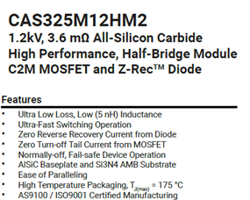
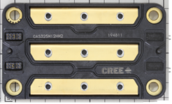
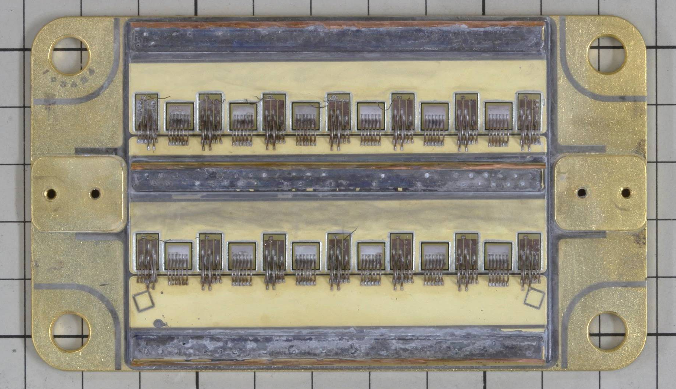
Preliminary announcement
WOLFSPEED (CREE) CAS325M12HM2 SiC MOSFET
POWER MODULE
Overview
Cover
removal
Source : Wolfspeed datasheet
▪ LTEC Corporation is planing to relase structure analysis report of the Wolfspeed manufactured 3.6mΩ, 1200V SiC half-bridge power module.
It will be released in Mar/2017.
▪ CAS325M12HM2 is used ‘High Performance 62mm’ state-of -art technology.
It realize the downsizing and lightening and High temperature operation (175C)
▪ The contents of the report includes how the module realize the downsizing , the lightening , the reducing parasitic impedance and High temperature operation (175C) through the analysis of package details, layout analysis, and materials analysis (EDX)
▪ 2nd gen SiC device is used in this module.
LTEC has prepared 2nd gen and 3rd gen SiC device analysis reports.

Slide 2
Table of Contents (Tentative)
Structure Analysis Section
1. Device summary, Table 1, Executive Summary
1.1. Analysis results
Table 2. Package structure overview
Table 3. Device structure: SiC MOSFET
Table 4. Device structure: Layer materials and thicknesses 2.Module analysis
2.1. Appearance observation
2.2 . Module constitution
2.3. Device constitution, Electro node layout and wire bonding
2.4. PCB layout for gate driver
2.5. Structure and material analysis of substrate , solder and base-plate
2.6. Resin FTIP (Glass-transition temperature)
2.7. Grain analysis of transistor metal and bonding wire (EBSD)

