Slide 1
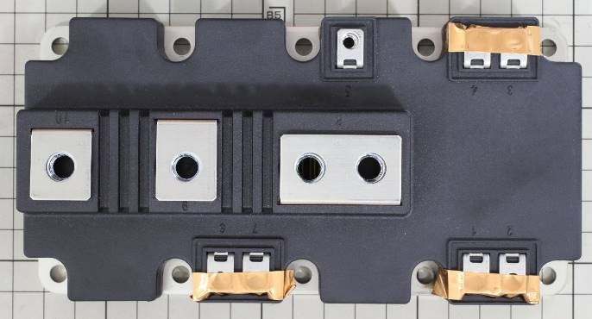
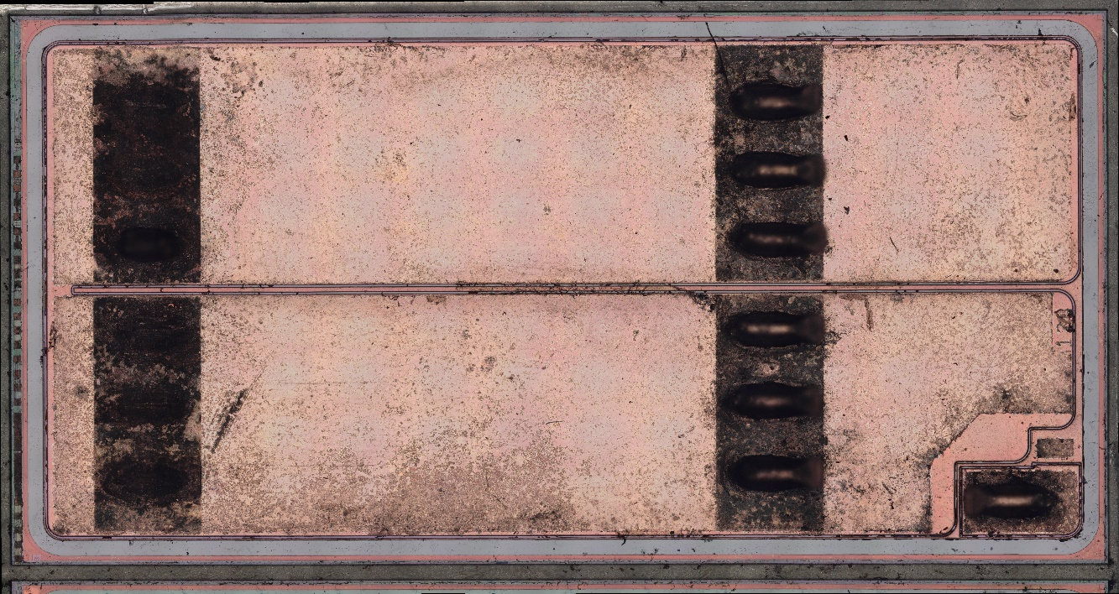
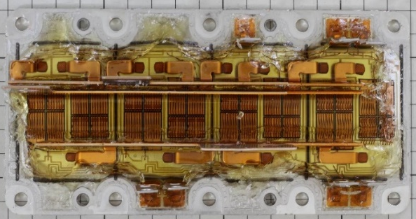
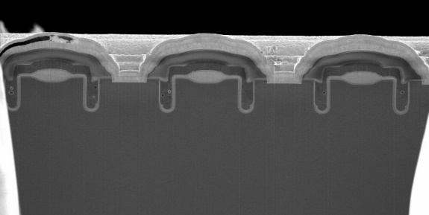
New
Release
INFINEON FF1200R12IE5 PRIME PACK™2 IGBT MODULE STRUCTURE ANALYSIS REPORT
November 2017. LTEC Corporation released a detailed structure and process analysis report of this new 1200V, 1200A half bridge IGBT power module using 5th generation IGBT device and forward diode. The new power module can operate at higher temperature (175Cº) and higher power density (1,200A) than previous versions.
Module 5th gen. IGBT die image
Module after resin removal SEM cross-section Reconstructed structure
In order to achieve high temperature operation and high power density, several new technologies are implemented within this new device:
Cu top metal and bond wire (Infineon XT technology TM )
Ag-sintered layer die attach
Dual-oxide trench to reduce Qg
The report has two individually purchasable sections: a 104-page Structure Analysis Section, and a 28-page Process Analysis section. The Structure Analysis Section reveals the physical construction of the device, including EDX materials analysis, and many other fine details. The Process Analysis Section includes manufacturing process flow and the estimated number of photo masking steps.

Slide 2
Table of Contents
Structure Analysis Report
Page
Device summary
Table 1, Executive Summary 3
Analysis results 4
Table 2. Module structure overview 6
Table 3. Device structure: Si IGBT 7
Table 4. Device structure: Layers, materials, and thicknesses 8
Module overview 9
Module cross-section analysis
Cross-section 18
EDX analysis 48
Si IGBT analysis
Plain view (optical microscope) 73
Plain view, Scanning Electron Microscope (SEM) 84
Cross-sectional structure analysis (SEM) 92

Slide 3
Table of Contents
Process Analysis Report
Page
Analysis summary 3
Comparison summary (Infineon 4th gen IGBT vs. 5th gen. IGBT) 4
Die 5
Die edge 6
XT technology (5th GEN. IGBT) 8
Device structure Si IGBT
Plan analysis 9
Cross section 13
Process flow (estimation)
Si IGBT front-end wafer process, estimated flow 19
Si IGBT process sequence cross-sectional view 20
Appendix
References 25
Patents 26
Comparison between IGBT4 & IGBT5 27

