Slide 1
New
Release
1200V SiC MOSFETs (Rohm, Wolfspeed, ON-Semi, Infineon)
Short-Circuit Robustness Benchmark Report
Feb. 2020: LTEC releases a report with analysis and comparison-benchmark of evaluated short-circuit withstand capabilities of state-of-the-art 1200V-rated SiC MOSFETs from ROHM, WOLFSPEED, ON-Semiconductor and INFINEON (CoolSiC) transistors. This is the world’s first assessment report with detailed comparison on short-circuit endurance.
The report provides data useful for system/circuit design, transistor modeling, and quality assurance (QA) considerations, as no short-circuit robustness limits for SiC power transistors are specified in the datasheets.
Background
There is a lack of information in the datasheet related to short-circuit robustness limits and modeling
Not all transistor manufacturers provide short-circuit endurance data such as short-circuit withstand time (SCWT, t_{sc,f}) and critical energy (E_{sc,f}) to failure.
Short-circuit benchmark data is insufficient among available SiC transistors.
Transistor short-circuit limitation depends not only on the physical properties of semiconductors, but also on transistor structural design and processing technology.
Lack of accuracy in thermal impedance Z_{th} data (and SPICE models) for power pulses with short pulse durations (1us-10us), within the range of short-circuit events. This fact prevents accurate simulations under short-circuit conditions.
In this report, we conduct actual short-circuit test measurements, transistor structure analysis, physical modeling and simulations are applied to evaluate, analyze and compare the short-circuit tolerance of SiC MOSFETs
Report Survey Contents
See Table of Contents on the next page
Main analysis and survey results
• For all SiC MOSFETs evaluated, device failure/destruction due to short circuit is a thermally-driven phenomenon. The transistor fails when it reaches a critical temperature (T_{j,crit}) instead of a critical energy.
The critical temperature for transistor failure is a technology-related parameter and depends on
(a) transistor design /structure, (b) material and manufacturing technology.
• The “universal plot” of short-circuit withstand time and power dissipation until failure enables fair comparison of different transistors. Criteria for using gate leakage current as a precursor to transistor degradation due to short circuit are considered. Based on this criterion, robust transistors can withstand up to 5us, while other transistors start to degrade (not destruct) at 2us.The influence of transistor scaling and the trade-off between short-circuit tolerance and on-resistance (performance) are considered.
Use of the evaluation results in this report
・ The minimum response time of the short-circuit protection circuit can be estimated.
・ The measured short-circuit drain current waveform and withstand time (t_{sc,f}) can be used in SPICE electrothermal simulation to estimate the internal temperature and critical failure energy (E_{sc,f}) of the transistor.
Note: For those who have purchased reports of the individual products, a discount price for this report is $ 6,000.

Slide 2
Table of Contents
 | 1.1 | Executive Summary | 2
 | 1.2 | Introduction | 5
 |  | Table 2: Glossary and abbreviations | 6
 | 2.1 | Motor inverter short circuit event | 7
 | 2.2 | Short-Circuit event Voltage/current waveforms | 8
 | 2.3 | Issues in short-circuit capability evaluation and modeling | 9
 | 2.4 | Use of data in this report | 10
 |  | Benchmark | 11
 |  | Evaluated 1200V-rated SiC MOSFETs ・ROHM SCT3080KLHR ・WOLFSPEED C3M075120K ・ONSEMI NVHL080N120SC1 ・INFINEON CoolSiC IMW120R045M1 | 12
 | 3.1 | Short-circuit test circuit. 3.2 Comparison of short-circuit drain current waveforms | 13
 | 3.3 | Short-circuit robustness (framework for evaluation and analysis model) | 16
 | 3.4 | Benchmark Results | 21
 |  | ・Comparison graph of short-circuit tolerance of 1200V SiC MOSFET→ “Universal plot” ・ Short circuit critical energy comparison: Esc,f ・Consideration on gate leakage current ・Table 4 Overview and comparison of electrical performance and short-circuit tolerance of 1200V SiC MOSFET ・ Short-circuit endurance and transistor scaling ・ Trade-off between short-circuit robustness and low on-resistance RON. | 22
 | 3.5 | Transistor structure and short-circuit robustness | 35
 |  | ・Structure analysis of the evaluated 1200 V SiC MOSFETs ・Transistor structure and technology improvement ・Reported failure due to short-circuit ・Source metal melting in INFINEON SiC MOSFET ・Strengthening the transistor short-circuit robustness | 36
 |  | Short circuit event simulation analysis | 42
 | 4.1 | Heat dissipation analysis | 44
 |  | ・Device structure-based thermal impedance analysis ・Modeling of Zth in short-circuit pulse range (~ us) | 45-
 | 4.2 | Short-circuit energy and temperature rise simulation | 51
 |  | ・Thermal impedance model comparison ・Analysis and estimation of temperature rise ΔTj (ROHM SCT3080KLHR) | 52 56
 |  | Conclusion | 57
 | 6.1 | References | 58
 | 6.2 | List of related LTEC analysis reports | 59
Appendix |  | 1. Analysis and estimation of temperature rise ΔTj | 61
 |  | 2. On short-circuit event in a half bridge power module | 62
 | 1.1 | Executive Summary | 2
 | 1.2 | Introduction | 5
 |  | Table 2: Glossary and abbreviations | 6
 | 2.1 | Motor inverter short circuit event | 7
 | 2.2 | Short-Circuit event Voltage/current waveforms | 8
 | 2.3 | Issues in short-circuit capability evaluation and modeling | 9
 | 2.4 | Use of data in this report | 10
 |  | Benchmark | 11
 |  | Evaluated 1200V-rated SiC MOSFETs ・ROHM SCT3080KLHR ・WOLFSPEED C3M075120K ・ONSEMI NVHL080N120SC1 ・INFINEON CoolSiC IMW120R045M1 | 12
 | 3.1 | Short-circuit test circuit. 3.2 Comparison of short-circuit drain current waveforms | 13-14
 | 3.3 | Short-circuit robustness (framework for evaluation and analysis model) | 16-20
 | 3.4 | Benchmark Results | 21
 |  | ・Comparison graph of short-circuit tolerance of 1200V SiC MOSFET→ “Universal plot” ・ Short circuit critical energy comparison: Esc,f ・Consideration on gate leakage current ・Table 4 Overview and comparison of electrical performance and short-circuit tolerance of 1200V SiC MOSFET ・ Short-circuit endurance and transistor scaling ・ Trade-off between short-circuit robustness and low on-resistance RON. | 22-34
 | 3.5 | Transistor structure and short-circuit robustness | 35
 |  | ・Structure analysis of the evaluated 1200 V SiC MOSFETs ・Transistor structure and technology improvement ・Reported failure due to short-circuit ・Source metal melting in INFINEON SiC MOSFET ・Strengthening the transistor short-circuit robustness | 36-41
 |  | Short circuit event simulation analysis | 42
 | 4.1 | Heat dissipation analysis | 44
 |  | ・Device structure-based thermal impedance analysis ・Modeling of Zth in short-circuit pulse range (~ us) | 45-50
 | 4.2 | Short-circuit energy and temperature rise simulation | 51
 |  | ・Thermal impedance model comparison ・Analysis and estimation of temperature rise ΔTj (ROHM SCT3080KLHR) | 52-55 56
 |  | Conclusion | 57
 | 6.1 | References | 58
 | 6.2 | List of related LTEC analysis reports | 59
 |  | A1. Analysis and estimation of temperature rise ΔTj | 61
 |  | A2. On short-circuit event in a half bridge power module | 62

Slide 3
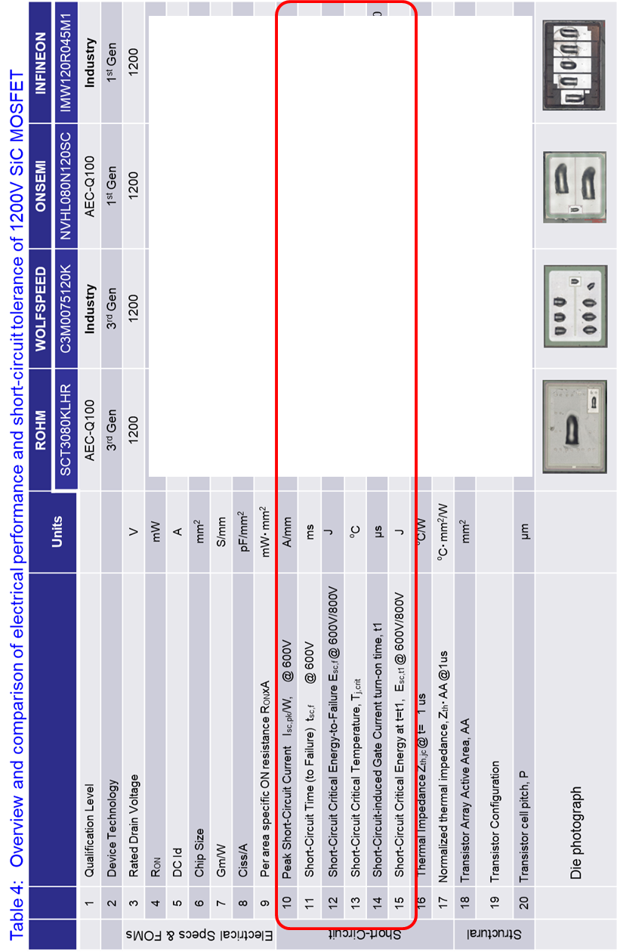

Slide 4
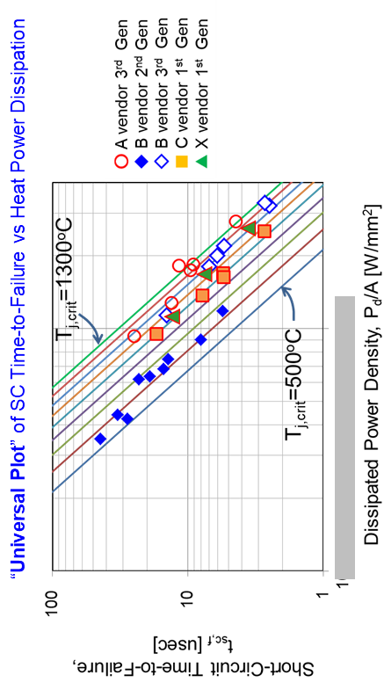
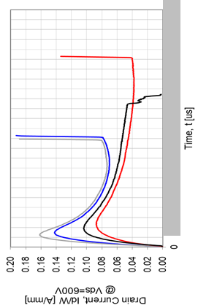
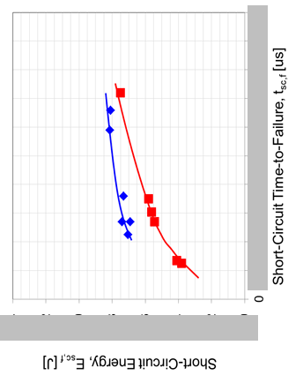
Fig.3.4.3： “Universal plot” of time-to-short-circuit failure (t_{sc,f}) against the heat dissipated power density (Pd/A) for several SiC MOSFETs.
The symbols represent actual measured data.
Fig. 3.4.5Comparison of short-circuit failure energy (Esc,f) for two devices.
Fig. 3.2.1: Comparison of normalized drain current Id/W

